Slide 1
Chapter 1 – Architectural Design
Software Architecture and Design
Mutah University
Faculty of IT
Department of Software Engineering
Dr. Ra’Fat A. AL-Msie’Deen
rafatalmsiedeen@mutah.edu.jo
https://rafat66.github.io/Al-Msie-Deen/

Slide 2
Reference - Text Book:
Chapter 6 of Software Engineering book - by Ian Sommerville. l0th Edition. Addison Wesley, 2015, ISBN-10: 0137035152.

Slide 3
Topics covered
Architectural design decisions
Architectural views
Architectural patterns
Application architectures

Slide 4
Application architectures Transaction processing systems Information systems Language processing systems

Slide 5
Language processing systems
Language processing systems translate one language into an alternative representation of that language and, for programming languages, may also execute the resulting code.
Compilers translate a programming language into machine code.
Other language processing systems may translate an XML data description into commands to query a database or to an alternative XML representation.
Natural language processing systems may translate one natural language to another, for example, French to Norwegian.

Slide 6
Language processing systems … cont.
A possible architecture for a language processing system for a programming language is illustrated in Figure 1.
The source language instructions define the program to be executed, and a translator converts these into instructions for an abstract machine.
These instructions are then interpreted by another component that fetches the instructions for execution and executes them using (if necessary) data from the environment.
The output of the process is the result of interpreting the instructions on the input data.

Slide 7
Language processing systems … cont.
Accept a natural or artificial language as input and generate some other representation of that language.
May include an interpreter to act on the instructions in the language that is being processed.
Used in situations where the easiest way to solve a problem is to describe an algorithm or describe the system data
Meta-case tools process tool descriptions, method rules, etc and generate tools.

Slide 8
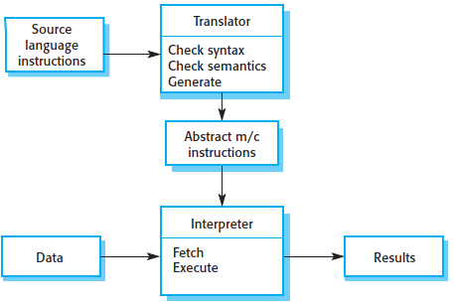
The architecture of a language processing system
Figure 1. The architecture of a language processing system.

Slide 9
Compiler components
For many compilers, the interpreter is the system hardware that processes machine instructions, and the abstract machine is a real processor.
However, for dynamically typed languages, such as Ruby or Python, the interpreter is a software component.
Programming language compilers that are part of a more general programming environment have a generic architecture (Figure 2) that includes the following components:

Slide 10
Compiler components … cont.
A lexical analyzer, which takes input language tokens and converts them into an internal form.
A symbol table, which holds information about the names of entities (variables, class names, object names, etc.) used in the text that is being translated.
A syntax analyzer, which checks the syntax of the language being translated. It uses a defined grammar of the language and builds a syntax tree.

Slide 11
Compiler components … cont.
A syntax tree, which is an internal structure representing the program being compiled.
A semantic analyzer, which uses information from the syntax tree and the symbol table to check the semantic correctness of the input language text.
A code generator, which “walks” the syntax tree and generates abstract machine code.
Other components might also be included that analyze and transform the syntax tree to improve efficiency and remove redundancy from the generated machine code.

Slide 12
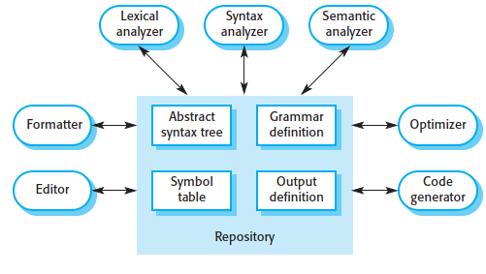
A repository architecture for a language processing system
Figure 2. A repository architecture for a language processing system.

Slide 13
Natural language translator
In other types of language processing system, such as a natural language translator, there will be additional components such as a dictionary.
The output of the system is translation of the input text.

Slide 14
A repository architecture for a language processing system … cont.
Figure 2 illustrates how a language processing system can be part of an integrated set of programming support tools.
In this example, the symbol table and syntax tree act as a central information repository. Tools or tool fragments communicate through it.
Other information that is sometimes embedded in tools, such as the grammar definition and the definition of the output format for the program, have been taken out of the tools and put into the repository.
Therefore, a syntax-directed editor can check that the syntax of a program is correct as it is being typed.
A program formatter can create listings of the program that highlight different syntactic elements and are therefore easier to read and understand.

Slide 15
A pipe and filter compiler architecture
Alternative Architectural patterns may be used in a language processing system (Garlan and Shaw 1993).
Compilers can be implemented using a composite of a repository and a pipe and filter model.
In a compiler architecture, the symbol table is a repository for shared data. The phases of lexical, syntactic, and semantic analysis are organized sequentially, as shown in Figure 3, and communicate through the shared symbol table.

Slide 16
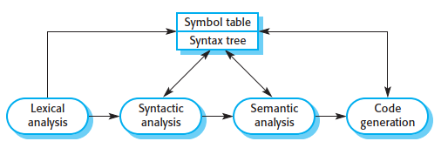
A pipe and filter compiler architecture … cont.
Figure 3. A pipe and filter compiler architecture.

Slide 17
A pipe and filter compiler architecture … cont.
This pipe and filter model of language compilation is effective in batch environments where programs are compiled and executed without user interaction; for example, in the translation of one XML document to another.
It is less effective when a compiler is integrated with other language processing tools such as a structured editing system, an interactive debugger, or a program formatter.
In this situation, changes from one component need to be reflected immediately in other components.
It is better to organize the system around a repository, as shown in Figure 2 if you are implementing a general, language-oriented programming environment.

Slide 18
Key points
Models of application systems architectures help us understand and compare applications, validate application system designs and assess large-scale components for reuse.
Language processing systems are used to translate texts from one language into another and to carry out the instructions specified in the input language.
They include a translator and an abstract machine that executes the generated language.

Slide 19
Exercises
You have been asked to prepare and deliver a presentation to a nontechnical manager to justify the hiring of a system architect for a new project. Write a list of bullet points setting out the key points in your presentation in which you explain the importance of software architecture.
Using the generic model of a language processing system presented here, design the architecture of a system that accepts natural language commands and translates these into database queries in a language such as SQL.

Slide 20
Chapter 2
Design and Implementation

Slide 21
Chapter 1 – Architectural Design
Software Architecture and Design
Mutah University
Faculty of IT
Department of Software Engineering
Dr. Ra’Fat A. AL-Msie’Deen
rafatalmsiedeen@mutah.edu.jo
https://rafat66.github.io/Al-Msie-Deen/

